Slide 1

PEDAGOGIC AL
UNIVERSIT Y
of KR AKOW

Slide 2

Pedagogical University
of Krakow as par t of the
Krakow Academic Centre
Krakow has more than 650 years of university tradition,
over 20 higher education institutions, almost 200,000 students,
numerous libraries, laboratories, as well as outstanding
academic staﬀ and unique study programmes. All of this
motivates young people from all over the world to choose
Krakow as the city to study in. Currently, students account
for almost a quarter of the entire city’s population.
fot. freepik.com

Slide 3

Pedagogical University
of Krakow in numbers
75 years of tradition
12 thousand students
nearly 60 ﬁelds of study
more than 200 specialties
13 doctoral programmes
more than 1,000 national
and international research and
development projects
3,000 academic publications
300 foreign partners,
including 217 universities
with which the Pedagogical
University cooperates under
the Erasmus+ programme
3,000 graduates annually
Academic Hotel Centre
fot. archiwuma Biura Promocji

Slide 4

Pedagogical University
of Krakow – the best
pedagogical university
in Poland
Pedagogical courses have been the core of the university’s curricula
since its fundation. However, the University also oﬀers several
philological, technical, engineering and natural science programmes.
According to the latest research
conducted by the Alumni
Cooperation Oﬃce
84% of graduates
recommend the
university to their
younger colleagues
fot. archiwuma Biura Promocji

Slide 5

Pedagogical University
of Krakow – a research
centre
The University is one of the most intensively developing
universities in the country. It is a recognised research centre.
Numerous national and international research projects are
conducted by the University’s faculty members with the use of
modern laboratories such as:
Mössbauer Spectroscopy Laboratory
Scanning Electron Microscopy Laboratory
X-Ray Diﬀraction Laboratory
Light Microscopy Laboratory
Geography and Nature Laboratory.
The University also
boasts of one of the
few astronomical
observatories in
Poland
fot. archiwuma Biura Promocji

Slide 6


The University has the right to provide
doctoral and postdoctoral degree
studies in many ﬁelds.
FACULTY OF HUMANITIES
doctoral degrees in: philosophy, history, linguistics,
literary studies
postdoctoral degrees in: history, linguistics, literary studies
FACULTY OF EXACT AND NATURAL SCIENCES
doctoral degrees in: mathematics, physical sciences, biological
sciences, Earth and environmental sciences
postdoctoral degrees in: biological sciences
FACULTY OF SOCIAL SCIENCES
doctoral degrees in: political sciences and public administration,
social and economic geography, land management, security sciences
postdoctoral degrees in: political sciences and public administration
FACULTY OF EDUCATION AND PSYCHOLOGY
doctoral degrees in: education
FACULTY OF ARTS
doctoral degrees in: ﬁne arts and art conservation
postdoctoral degrees in: ﬁne arts and art conservation

Slide 7

Fields of study
Administration
Computer Science
Information Architecture
Archival Studies, Document
Management and Information
Brokering
Security Engineering
Cognitive Science
Visual Communication
Cultural and Media Studies
Speech Therapy
Art & Design
International Security
State Security
Painting
Mathematics
Health Security
Bioinformatics
Biology
Biologic Rejuvenation
Environmental Protection
Education
Chemistry – Chemistry Teacher
Digital
Digital Design
Pre-School and Early School Education
Special Needs Education
Political Science
IT Education
Social Policy
International Security
Social Economy
Social Work
Law
Ethics – Mediations and Negotiations
English Philology
Germanic Philology
Spanish Philology (Iberian Studies)
Polish Philology
Romance Philology
Russian Philology
Italian Philology
Philosophy
Psychology
Sociology
International Relations
German and Central European Studies
Art and Education
Modern Art
Art and Media
Historical Tourism and Cultural
Heritage
Physics
Geography
Spatial Management
Graphics
History
Tourism and Recreation
Information Management
Administration of Education
and Non-Governmental Organisations
Management in Social Services

Slide 8
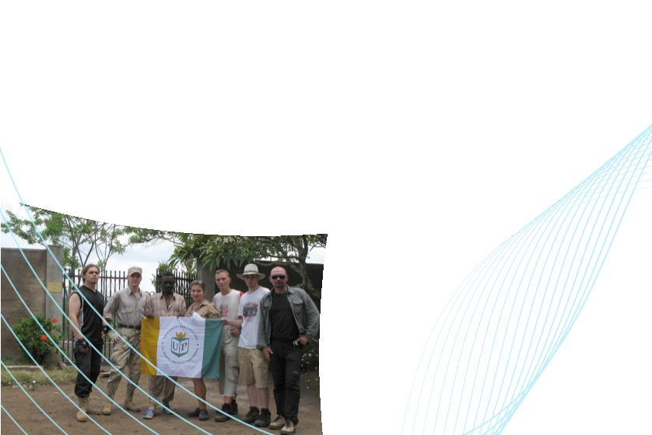
Pedagogical
University of Krakow –
internationalisation
Over 200 international students from all around the world
are welcome to study for a semester or a year within the
Erasmus+programme. This international scheme allows incoming
students to take modules at the Pedagogical University of Krakow
that transfer back and count towards their degree at home
institution.
Thanks to foreign studies under the Erasmus+ programme,
students can improve their communication, language and
intercultural skills, as well as gain soft skills that are very much
appreciated by employers (communication, assertiveness, creativity,
resistance to stress, leadership skills, the ability to cooperate with
other people and work independently as well as time management).
fot. archiwuma Biura Promocji

Slide 9



International Cooperation
The University cooperates with nearly 300 universities all EU
member and associated countries, as well as from Albania, Armenia,
Belarus, Georgia, India, Iran, Israel, Jordan, Cambodia, Kazakhstan,
Mexico, Moldova, Russia, South Africa, El Salvador, Uganda, USA,
Uzbekistan and Vietnam.
Double-diploma Programmes
Our students are given an opportunity to obtain diplomas from
two diﬀerent universities at the same time.
Currently, the following universities are our “double-diploma”
pratners:
Karlova Univerzita
Université Grenoble-Alpes (UGA)
École supérieure d’art des Pyrénées
Moscow State Pedagogical University
Oles Honchar Dnipro National University
National Pedagogical Dragomanov University
fot. archiwuma Biura Promocji

Slide 10


Students coming to the University
as par t of international exchange
are oﬀered a wide range of support
including:
Course of Polish language, culture, and history
Orientation week for new incoming students
“Buddies” scheme
Assistance in study issues (e.g., course timetables, attendance,
coursework, libraries), as much as in everyday life (e.g., public
transport, medical service, shopping, leisure)
Accommodation on the university’s premises
To libraries, laboratories, sport facilities, etc.
fot. archiwuma Biura Promocji

Slide 11


Useful information
Legalisation of stay
Foreign students from outside the EU should have a visa authorising
them to enter the territory of Poland. The visa can be obtained at the
Consulate of the Republic of Poland in the country of origin on the
basis of a decision on admission to the University. For details, please
visit www.msz.gov.pl or the Polish diplomatic mission in your place
of residence. The formalities related to the legalisation of stay in the
territory of the Republic of Poland can be settled at the Citizen and
Foreigner Aﬀairs Department of the Malopolska Voivodeship Oﬃce in
Krakow.
Health insurance
Foreign students must have valid health insurance for the duration
of their study.
fot. archiwuma Biura Promocji

Slide 12

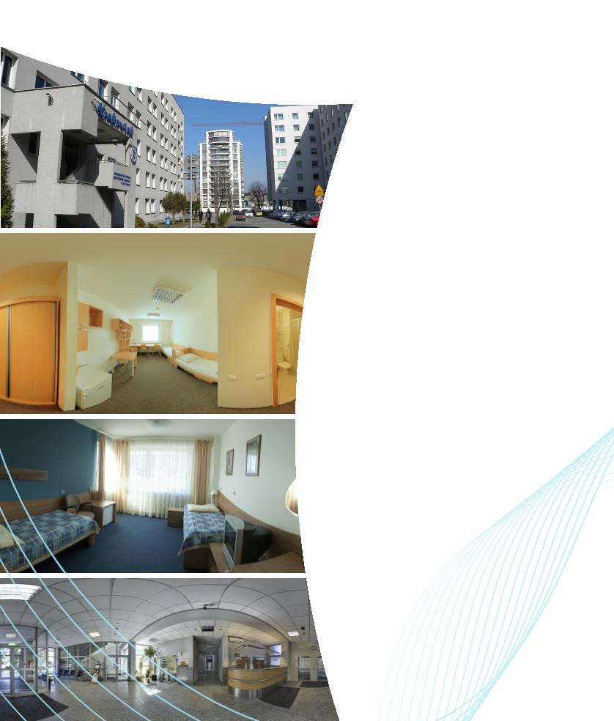
Accommodation
The University oﬀers limited accommodation in its dormitories.
For details please visit:
www.stypendia.up.krakow.pl
fot. archiwuma Biura Promocji

Slide 13


Pedagogical University
of Krakow
Podchorążych 2
30-084 Krakow, Poland
phone number +48 12 662 60 14
info@up.krakow.pl
www.facebook.com/Uniwersytet.Pedagogiczny
www.up.krakow.pl/en
Contact
International Relations Oﬃce
bwm@up.krakow.pl
magdalena.birgiel@up.krakow.pl
Recruitment Oﬃce
rekrutacja@up.krakow.pl
fot. Ł. Lic pozytyw.studio.com

