Slide 1
Moodle Learning Environment includes:
1. Controls for assigning different roles (i.e. administrator or user)
2. Means of evaluation of student achievements
3. Means of self-education
4. Lesson (lecture) tool
5. Explanation (text and graphics)
6. Glossary tool
7. Communication tools

Slide 2
Distance learning with Moodle
realizes the basic didactic principles:
• interactivity
• personalization
• adaptability
• visibility
• agility of multiple accesses to educational
information

Slide 3
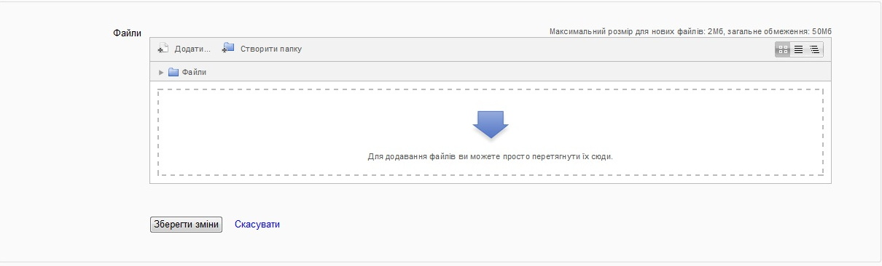
Moodle drag’n’drop interface for files

Slide 4
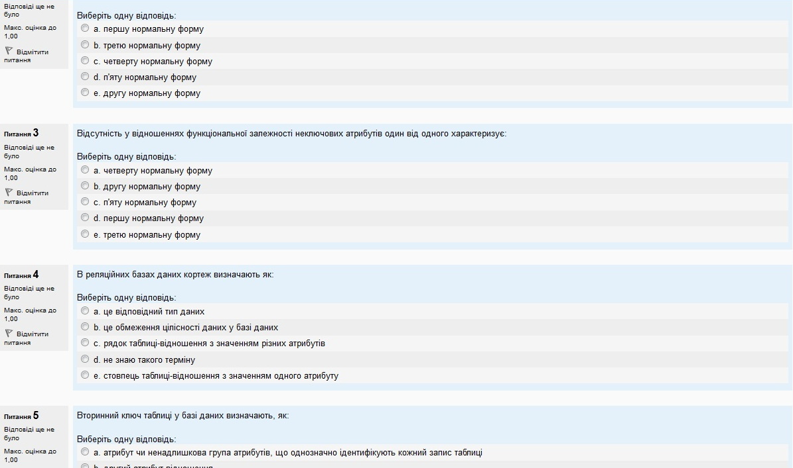
Moodle interface for tests design

Slide 5
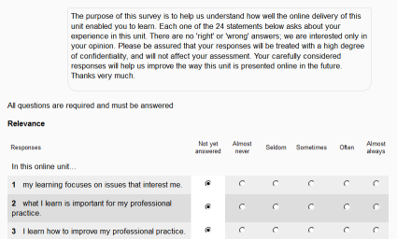
Moodle survey module

Slide 6
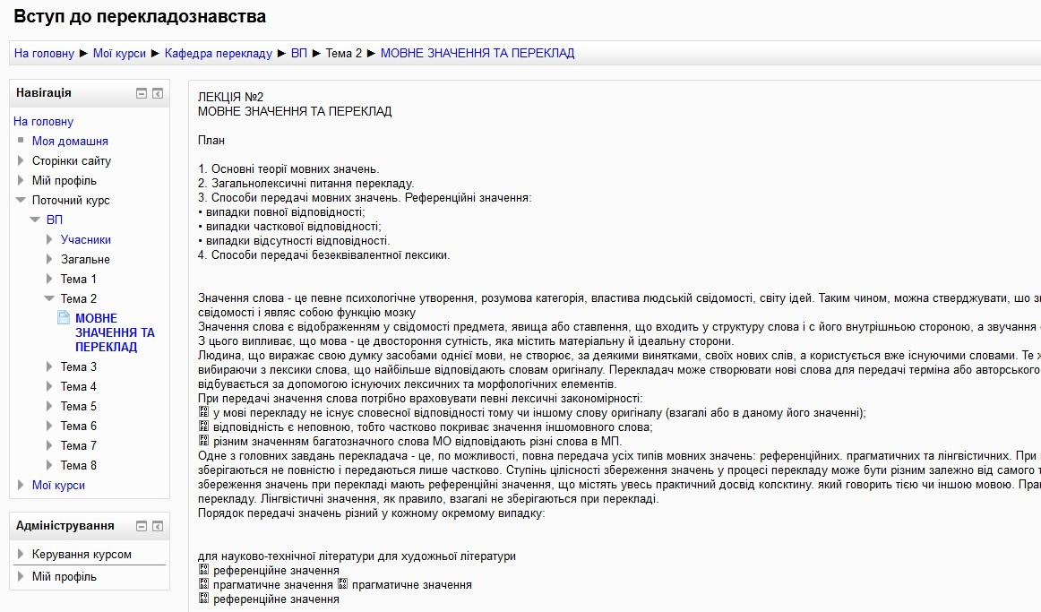
Moodle lesson module

Slide 7
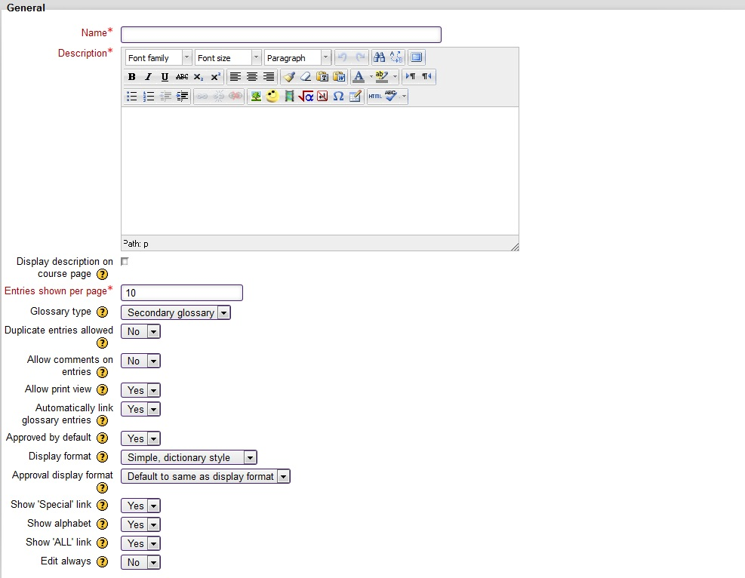
Moodle glossary module

Slide 8
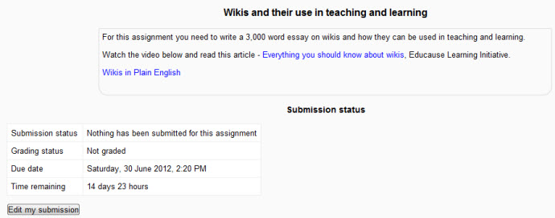
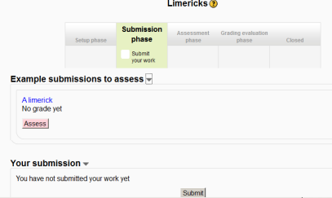
Moodle workshop and assignment modules

Slide 9
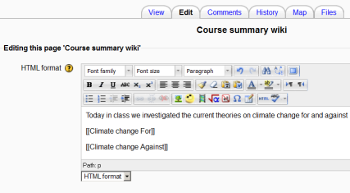
Moodle wiki module

Slide 10
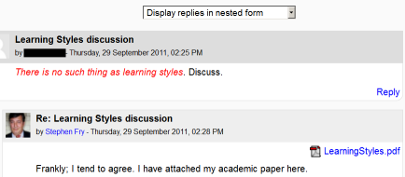
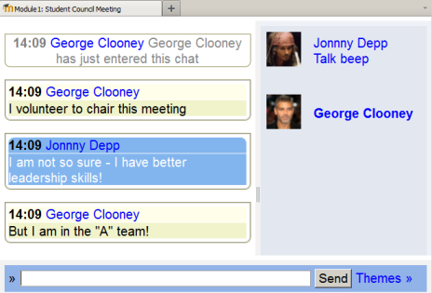
Moodle forum and chat modules

Slide 11
Thank you!

